Slide 1
Logic Networks (Discrete Mathematics)
kobriendublin.wordpress.com
Twitter: @statslabdublin

Slide 2
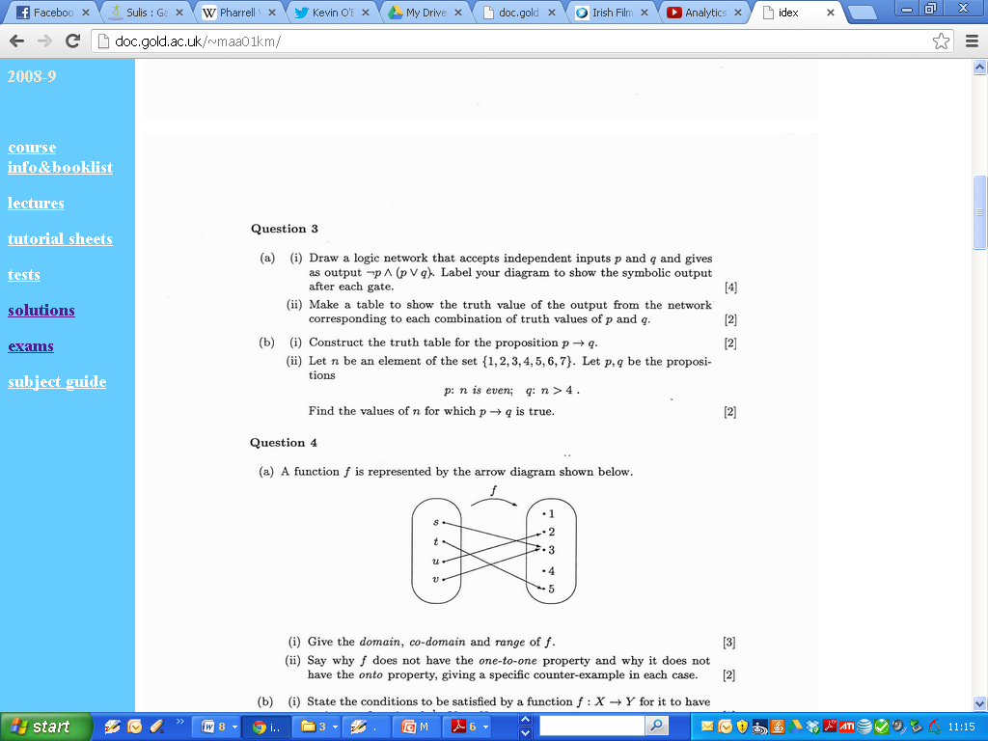
Logic Networks

Slide 3
Logic Networks

Slide 4
Logic Networks

Slide 5
Logic Networks

Slide 6
Logic Networks

